Slide 1


Restructuring Endpoint Congestion Control
Akshay Narayan, Frank Cangialosi, Deepti Raghavan, Prateesh Goyal, Srinivas Narayana, Radhika Mittal, Mohammad Alizadeh, Hari Balakrishnan
SIGCOMM 18’ : Proceedings of the 2018 Conference of the ACM Special Interest Group on Data Communication
Dong Hyeon Lee
Chung-Ang University
enjoying1018@naver.com
Feb. 24th 2022

Slide 2
Goal of this paper
Easy implement & Use lot of library in user-space
when implementing congestion control algorithm

Slide 3
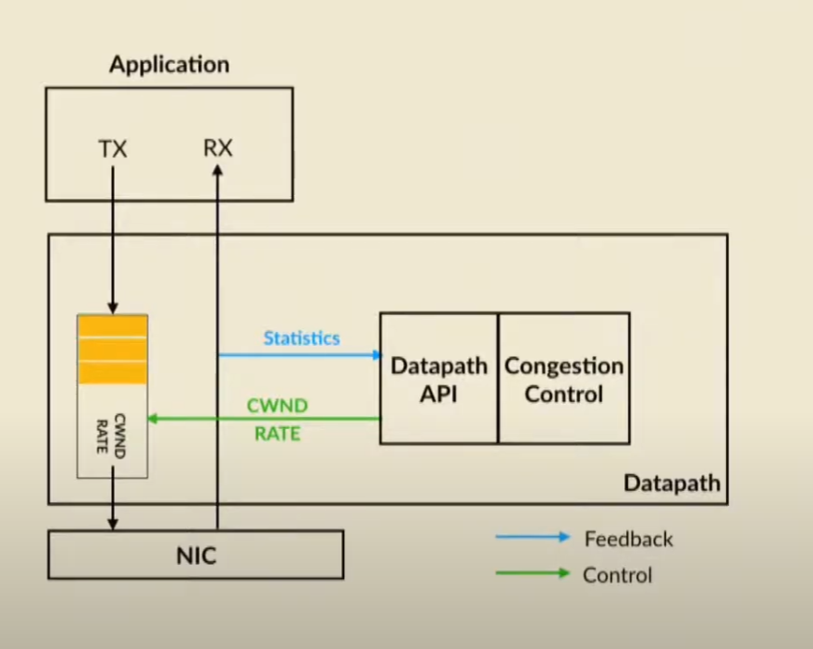
Current Design (1)

Slide 4
Current Design (2) - Shortcoming
Lacking useful libraries
New datapaths offer limited choices for congestion control
*datapaths = linux, windows, android … + new hardware
Hard to implement … (takes a lot of time)

Slide 5
CCP(Congestion Control Plane) (1)
Instead, the datapath encapsulate the info ( RTT, losses …) and provide this info to off-datapath module, then congestion control algorithms could run in the context of that module.
The datapath have to be modified , but this effort needs to be undertaken
only once.

Slide 6
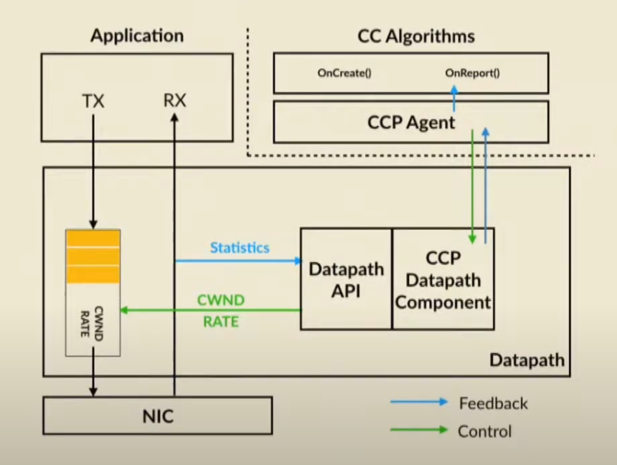
CCP(Congestion Control Plane) (2)

Slide 7
CCP(Congestion Control Plane) (3)
Benefits
1) Write-once, run-anywhere
2) Higher pace of development
= provide a low-barrier programming environment and access to libraries
3) New capabilities

Slide 8
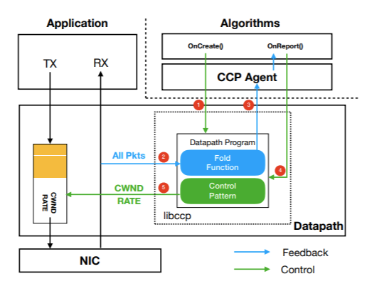
CCP(Congestion Control Plane) (4)

Slide 9
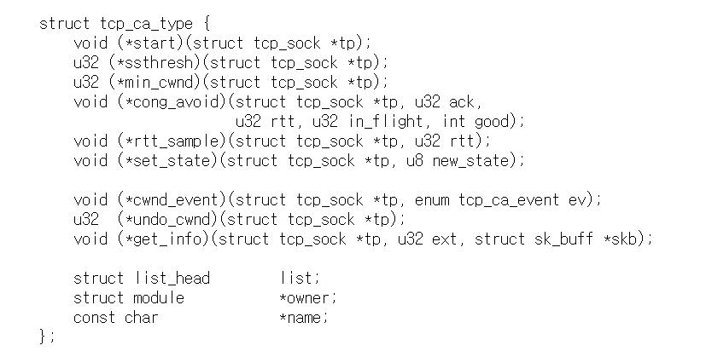
CCP(Congestion Control Plane) (5) – Datapath API
Datapath API = Pluggable TCP API
Each of the methods in this structure is a hook into the TCP code which allows the algorithm to obtain information(rtt, delay, timeouts) on network conditions

Slide 10
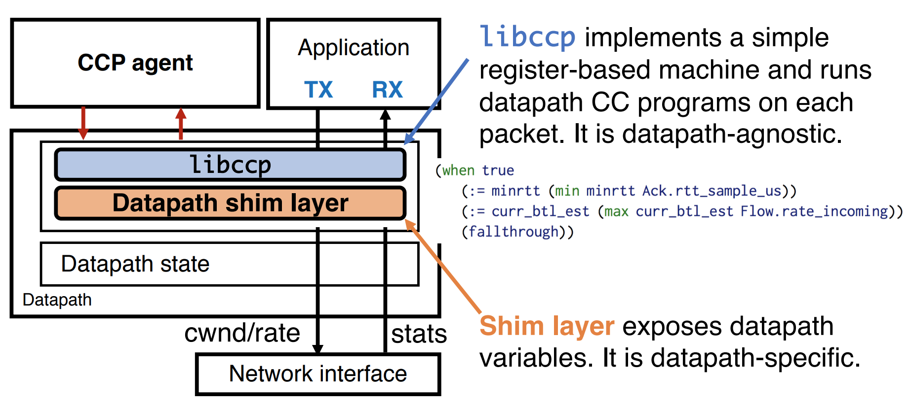
CCP(Congestion Control Plane) (6)

Slide 11
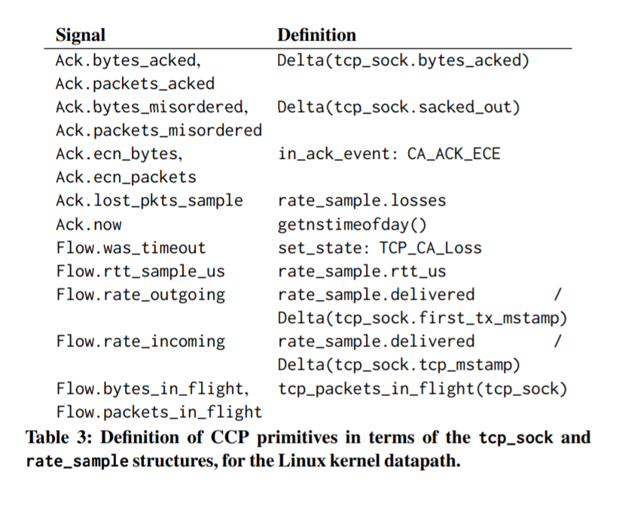
CCP(Congestion Control Plane) (7) – shim layer

Slide 12
CCP(Congestion Control Plane) (6) - libccp
libccp
= provides a reference implementation of CCP’s datapath component, in order to simplify CCP datapath development.
= lightweight execution loop for datapath programs and message serialization.
Use Ebpf( TCP BPF)
-> make libccp portable to datapaths outside the Linux Kernel
To use libccp…
Datapath must provides callbacks
Set the window and rate
Provide a notion of time
Send a IPC message to CCP

Slide 13
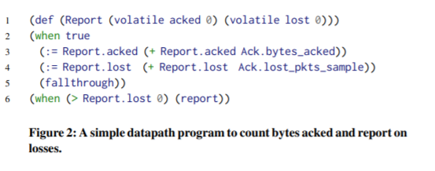
CCP(Congestion Control Plane) (8) - libccp
Datapath use libccp
Example >
Ccp_read_msg()
-> reading message from CCP, the datapath calls ccp_recv_msg()
= which automatically demultiplexes the message
Ccp_invoke()
= run the datapath program
Ccp_read_msg(){
A();
}

Slide 14
CCP(Congestion Control Plane) (9)

Slide 15
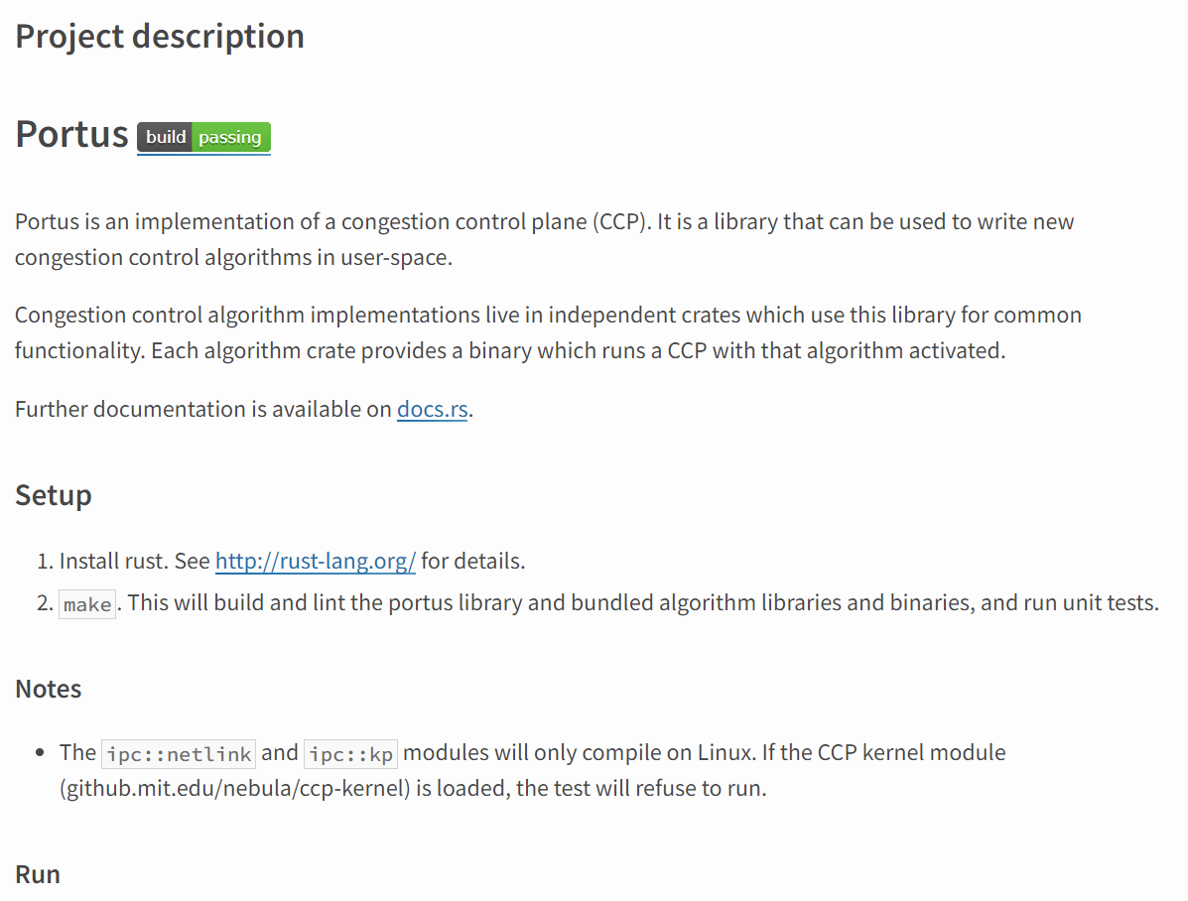
CCP(Congestion Control Plane) (10) –CCP Agent
CCP Agent
= called Portus
Implement in Rust

Slide 16

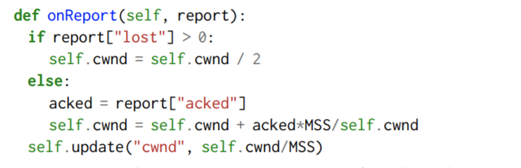
CCP(Congestion Control Plane) (11)

Slide 17
CCP(Congestion Control Plane) (12) - Extra
Decoupling Congestion Control from the ACK Clock
Github!!
https://github.com/ccp-project
https://ccp-project.github.io/ccp-guide/setup/index.html

Slide 18
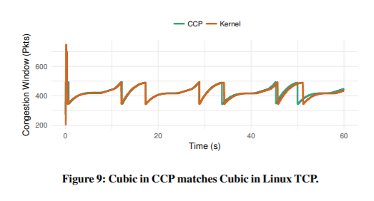
Result(1)
Ns-2 simulator
Linux 4.14.0
Cpu = 4 core 2.8 Ghz
Memory = 64GB

Slide 19
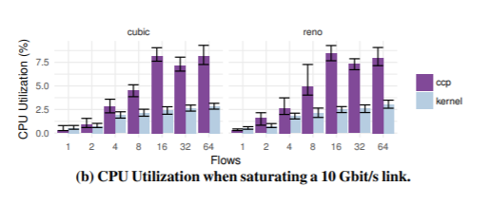
Result(2)

Slide 20
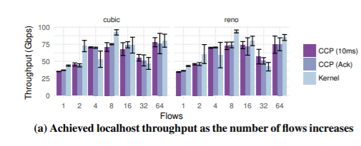
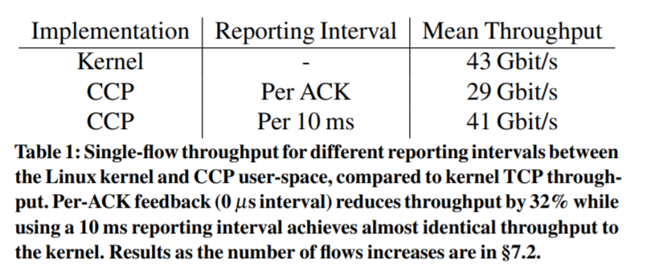
Result(3)

Slide 21



Thank you!

